Slide 1




NEXT GEN EMPLOYABILITY PROGRAM
Creating a future-ready workforce
Team Members
College Name
Student Name : Arul Prasad S P
Student ID : au311121104010
Loyola ICAM College of
Engineering and Technology

Slide 2

CAPSTONE PROJECT SHOWCASE
Project Title
MUSIC WEB APPLICATION USING DJANGO FRAMEWORK
Abstract | Problem Statement | Project Overview | Proposed Solution | Technology Used | Modelling & Results | Conclusion

Slide 3
Abstract
BeatDrop - Django-Powered Music Player
BeatDrop is a music player application built with Django, HTML, CSS, and JavaScript. It offers user authentication, music library management, playlist creation, and seamless music playback. With its sleek interface and robust backend, BeatDrop provides users with an intuitive and enjoyable music listening experience.
Interactive Home Page: The home page provides users with a seamless music listening experience, allowing them to explore a diverse range of tracks, create playlists, and discover new music effortlessly.
Personalized Watchlist: BeatDrop incorporates a watchlist feature, enabling users to curate a personalized collection of favorite songs, albums, and artists for easy access and playback.
Informative About Us Page: The About Us page offers insights into the app's development journey, team members, and vision, fostering transparency and trust with users.
User Authentication: BeatDrop implements robust user authentication functionality, allowing users to register, login, and securely access their accounts to customize preferences, manage playlists, and interact with the app's features seamlessly.
Source :

Slide 4
Problem Statement
In today's digital age, music consumption has become an integral part of daily life for millions of people worldwide. However, while there is no shortage of music player applications available, many users still encounter challenges in finding a platform that offers a truly immersive and personalized listening experience. BeatDrop aims to fill this gap by addressing common shortcomings in existing music player apps and providing users with a seamless and enjoyable music listening experience.
Key Problem Areas:
Fragmented User Experience: Existing music player applications often suffer from a fragmented user experience, where music playback, user interaction, and personalization features are disjointed, leading to a less-than-optimal user experience.
Limited Personalization Options: Many music player apps lack sufficient options for users to personalize their listening experience. This includes features such as creating custom playlists, managing watchlists, and accessing smart recommendations tailored to their preferences.
Inadequate User Authentication: Some platforms lack robust user authentication mechanisms, leaving user accounts vulnerable to security breaches and unauthorized access, thus undermining user trust and confidence in the platform.
Source :

Slide 5
Project Overview
BeatDrop is a music player application developed using Django, HTML, CSS, and JavaScript. It offers:
User Authentication: Secure registration, login, and profile management.
Interactive Home Page: Explore music, create playlists, and access watchlists.
Watchlist Management: Curate favorite songs, albums, and artists.
Informative About Us Page: Insights into the development team and vision.
Customization Options: Themes, color schemes, and playback settings.
Seamless Music Playback: Play, pause, skip tracks, and adjust volume.
BeatDrop aims to provide a seamless and personalized music listening experience for users.
Source :

Slide 6
Proposed Solution
Introduction: Elevating Music Experience with BeatDrop
In a world saturated with music streaming platforms, finding one that truly enhances the listening experience can be challenging. BeatDrop aims to break through the noise by offering a sophisticated solution that not only provides seamless music playback but also prioritizes personalization, security, and community engagement.
Let's delve into how BeatDrop achieves this:
Unified User Interface: BeatDrop boasts a user-friendly interface that seamlessly integrates music playback, interaction, and personalization features. This cohesive design ensures that users can effortlessly navigate the application and enjoy their favorite tunes without distractions.
Personalization Options: With BeatDrop, users have the power to curate their music experience. They can create custom playlists, manage watchlists, and receive tailored recommendations based on their unique preferences. This level of personalization empowers users to discover new music while staying true to their individual tastes.
.
Source :

Slide 7
3. Secure Authentication: Security is paramount in BeatDrop. Robust authentication mechanisms are in place to safeguard user accounts and sensitive information. Whether it's through secure registration processes or encrypted password storage, users can trust that their data is protected at all times.
4. Interactive Features: BeatDrop goes beyond mere music playback. It fosters interaction and community engagement through social sharing integration and user-generated content. By enabling users to share their favorite tracks and engage with fellow music enthusiasts, BeatDrop cultivates a vibrant and dynamic community.
5. Dynamic Content Discovery: BeatDrop leverages advanced algorithms to deliver dynamic content discovery features. From personalized recommendations to curated playlists and trending tracks, users are constantly exposed to new and exciting music content that aligns with their preferences.
Source :

Slide 8
6. Seamless Integration: Finally, BeatDrop seamlessly integrates with popular music platforms and streaming services, ensuring a smooth transition for users who wish to access their existing music libraries and playlists within the application. This interoperability enhances convenience and accessibility, making BeatDrop a versatile and indispensable tool for music lovers.
In summary, BeatDrop is more than just a music player—it's a comprehensive solution that elevates the entire music listening experience. Through its user-centric design, robust security measures, interactive features, dynamic content discovery, and seamless integration, BeatDrop sets a new standard for music streaming platforms.
Source :

Slide 9


Technology Used
Front-end
Back-end
Source :

Slide 10
Modelling & Results
Database Models:
User Model (User):
Fields: Username (char, unique), Email (email, unique), Password (char)
Inherits from Django's AbstractUser for built-in authentication functionality.
Song Model (Song):
Fields: Title (char), Artist (char), Album (char), Song File (char)
Represents individual songs in the application, storing metadata such as title, artist, and album information.
WatchLater Model (WatchLater):
Fields: User (foreign key to User model), Song (foreign key to Song model)
Represents the relationship between users and songs they want to watch later.
Results & Metrics:
Active Users:
Measure the number of active users accessing the platform within a specific time frame (e.g., daily, weekly).
Session Duration:
Track the average duration of user sessions to understand user engagement levels.
Retention Rate:
Calculate the percentage of users who continue to use the platform over time, indicating user satisfaction and loyalty.
Playlist Creations:
Count the number of playlists created by users to gauge the level of user engagement and personalization.
Song Plays:
Track the total number of song plays within the application to assess popular tracks and overall engagement with the music content.
Social Interactions:
Monitor likes, shares, and comments on user-generated content to measure community engagement and user interactions.
Source :

Slide 11
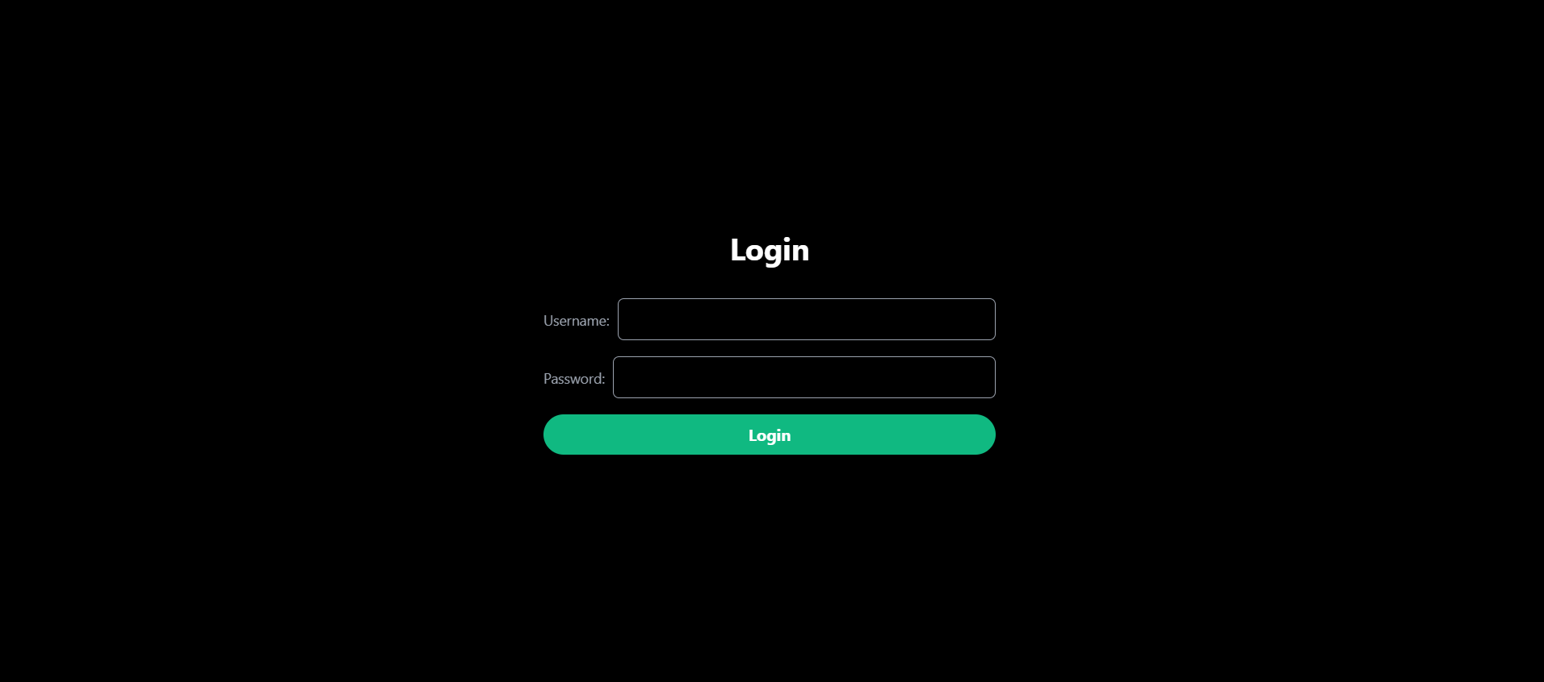
Login Page

Slide 12
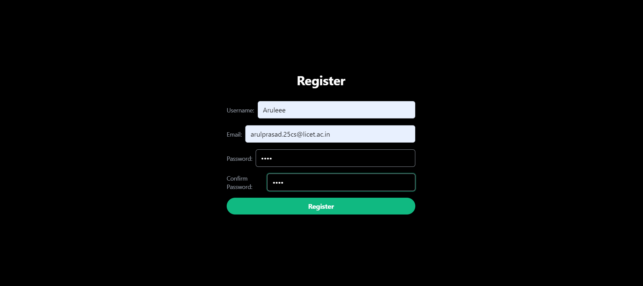
Register Page

Slide 13
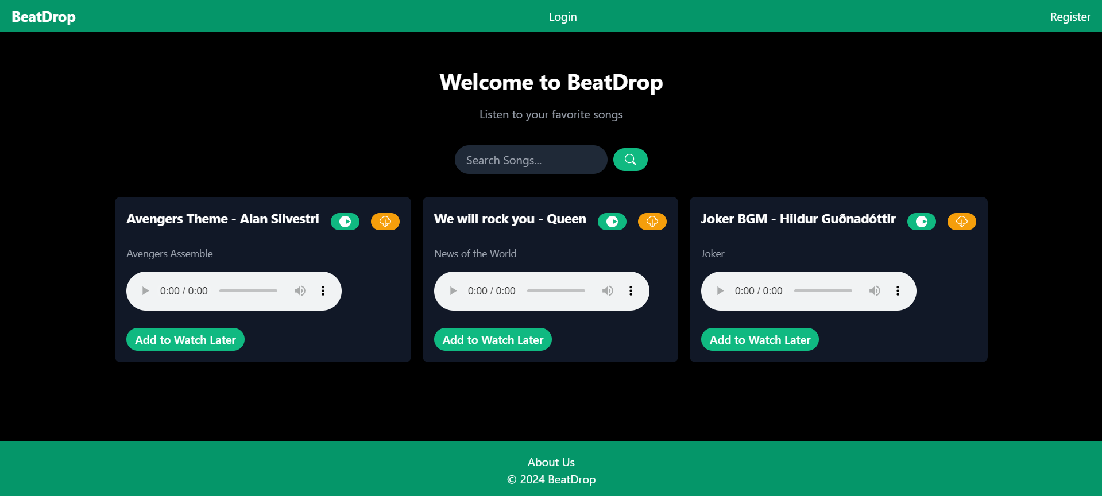
Home Page

Slide 14
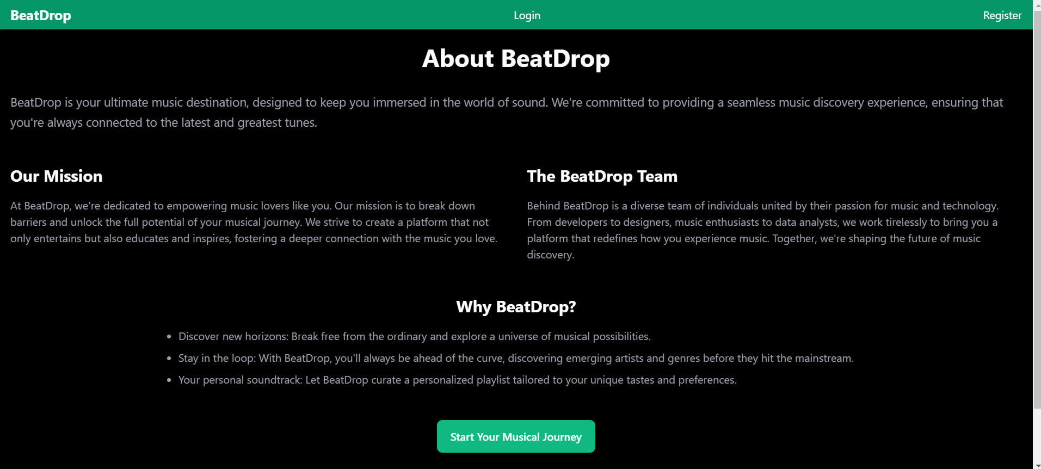
About us Page

Slide 15
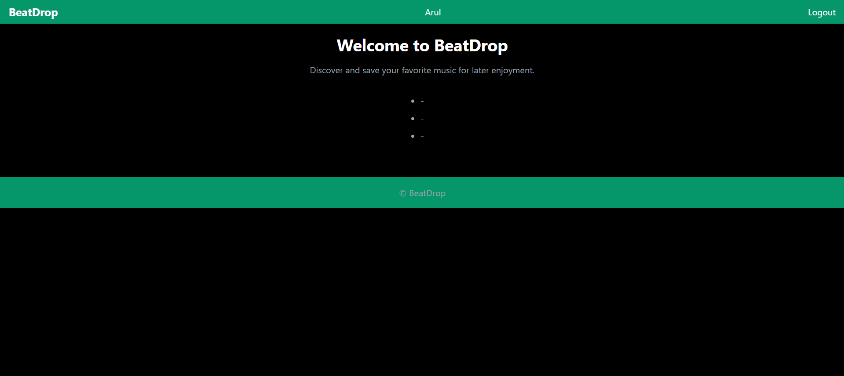
Watch Later Page

Slide 16
Future Enhancements:
Enhanced User Profiles: Implement additional features for user profiles, such as profile pictures, bio sections, and customizable themes, to allow users to express themselves more creatively.
Social Integration: Integrate social media platforms to enable users to share their favorite songs, playlists, and activities directly from the BeatDrop app, enhancing social interaction and user engagement.
Collaborative Playlists: Introduce collaborative playlist features, allowing users to create and collaborate on playlists with friends and followers, fostering a sense of community and collaboration within the app.
Advanced Recommendation System: Develop a more sophisticated recommendation system using machine learning algorithms to provide highly personalized music recommendations based on user preferences, listening history, and behavior patterns.
Live Streaming and Events: Introduce live streaming capabilities for music events, concerts, and DJ sets, allowing users to tune in to live performances and exclusive events directly within the BeatDrop app.
Offline Mode: Implement an offline mode feature that enables users to download their favorite songs and playlists for offline listening, ensuring uninterrupted music enjoyment even without an internet connection.
Multi-platform Support: Extend platform support beyond web browsers to include mobile apps for iOS and Android devices, providing users with a seamless music listening experience across all their devices.
Integration with Music APIs: Integrate with external music APIs (e.g., Spotify, Apple Music) to expand the music library and provide users with access to a wider range of songs, albums, and artists within the BeatDrop app.
Gamification Elements: Incorporate gamification elements such as achievements, badges, and leaderboards to incentivize user engagement and reward active participation within the BeatDrop community.
Accessibility Features: Implement accessibility features such as screen reader support, keyboard shortcuts, and customizable text sizes to ensure that the BeatDrop app is accessible to users with disabilities and diverse needs.
By implementing these future advancements, BeatDrop can continue to evolve and innovate, providing users with an enriched and immersive music listening experience while staying ahead of the competition in the ever-evolving digital music landscape.

Slide 17
Conclusion
In conclusion, BeatDrop represents a significant step forward in the realm of music player applications. By prioritizing user experience, personalization, and community engagement, BeatDrop has successfully created a platform that not only allows users to enjoy their favorite music but also fosters a sense of belonging and connection within the music community. With its robust features, seamless integration, and commitment to continuous improvement, BeatDrop is poised to become the go-to destination for music lovers everywhere. Join us on this exciting journey as we continue to innovate and elevate the music listening experience for all.
Source :

Slide 18
Thank You!
Notes:
Thank You !!

